Slide 1
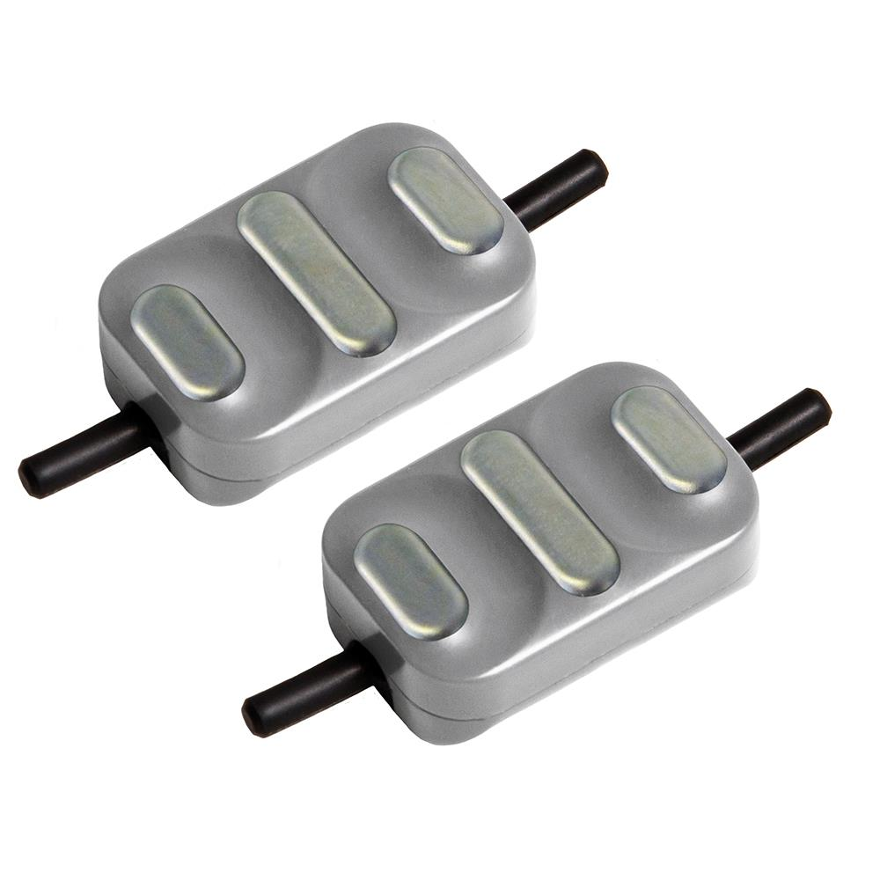
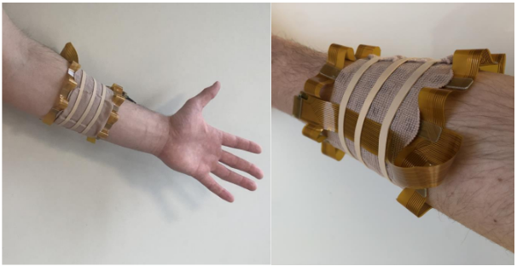
Context: Control of hand prostheses through the analysis of myoelectric signals (generated by muscles)
Use of electrodes for signal acquisition
Common on the market:
Low number of electrodes for prosthesis control
Problems
Low electrode count/density
Steeper Group, “Electrodes & Cables,” Steeper Group. [Online]. [Accessed: Jul. 10, 2026]
F. Chamberland et al., « EMaGer: A Wearable Full-Circumference HD-EMG Sensor and Data Augmentation Method for Robust Hand Gesture Recognition », dans 2023 45th Annual International Conference of the IEEE Engineering in Medicine & Biology Society (EMBC), Sydney, Australia: IEEE, juill. 2023, p. 1‑5

Slide 2
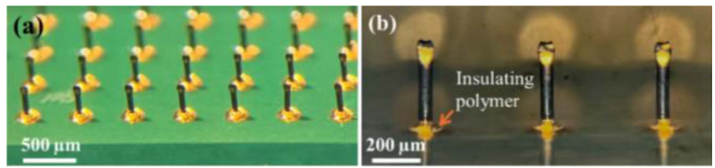
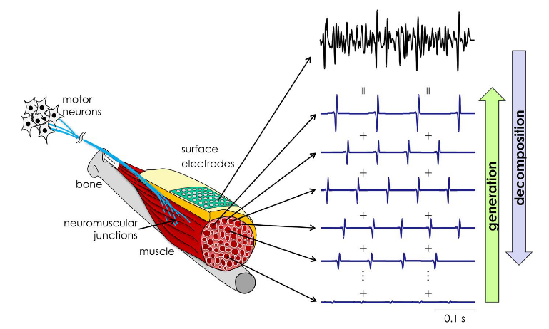
Project: Development of an ultra-high-density electrode array
Up to 512 electrodes
5 mm between each electrode
Microneedles for each electrode
Objective:
Validate the performance of myoelectric signal analysis algorithms
Test a myoelectric signal analysis method
Decomposition of signals into motor neuron impulses (Motor Unit Action Potentials)
Allows the behavior of motor neurons to be analyzed at the source
Potential applications:
Prostheses
Muscle rehabilitation
Diagnosis of neurological diseases
K. Haider, T. Tilly, V. Coyle, et C. Dalton, « Scalable and Customizable Trimaterial Microneedle Electrochemical Biosensor Platform With Cleanroom-Free Fabrication », IEEE Sens. Lett., vol. 9, nº 9, p. 1‑4, sept. 2025
D. Farina et A. Holobar, « Characterization of Human Motor Units From Surface EMG Decomposition », Proc. IEEE, vol. 104, nº 2, p. 353‑373, févr. 2016

